Slide 1
CSC 112: Computer Operating Systems Lecture 2 Processes and Threads
Department of Computer Science,
Hofstra University
Acknowledgement: Lecture slides based on UC Berkeley CS 162: Operating Systems and System Programming

Slide 2
Overview
Process concept
Process state
Process API (creation, wait)
Process tree

Slide 3
Process
Program is a static entity stored on disk (executable file), process is active
Program becomes process when executable file loaded into memory
Process is an abstraction of CPU
Execution of program started via Graphic User Interface (GUI) mouse clicks, command line entry of its name, etc
A physical CPU is shared by many processes
Time sharing: run one process for a little while, then run another one, and so forth.
Processes believe they are using CPU alone

Slide 4
Process
CPU
Memory
A program becomes a process when it is selected to execute and loaded into memory.
A process has an address space
Program Counter (PC)
code
static data
heap
stack
Process
Loading:
Takes on-disk program
and reads it into the address space of process
code
static data
Program
Disk
Notes:
address space is the range of memory assigned to a process

Slide 5
Process
Process: a running program
Consists of:
Stack: Temporary data, e.g., function parameters, return addresses, local variables
Heap: Dynamically allocated memory
Static data: Global variables
Code: Instructions
Registers: SP (Stack Pointer), PC (Program counter)
0xFFFFFFFF
stack
(temporary data)
SP (Stack Pointer)
32-bit memory
address space
heap
(dynamic allocated mem)
static data
(data segment)
code
(text segment)
PC (Program Counter)
0x00000000
Notes:
Malloc to define, but you also need to free it.
Trampoline includes the code to transition in and out of the kernel
Trapframe saves the state of the process
general purpose reg

Slide 6
Process
struct proc {
struct spinlock lock; // p->lock must be held when using these:
enum procstate state; // Process state
void *chan; // If non-zero, sleeping on chan
int killed; // If non-zero, have been killed
int xstate; // Exit status to be returned to parent's wait
int pid; // Process ID
// wait_lock must be held when using this:
struct proc *parent; // Parent process
// these are private to the process, so p->lock need not be held.
uint64 kstack; // Virtual address of kernel stack
uint64 sz; // Size of process memory (bytes)
pagetable_t pagetable; // User page table
struct trapframe *trapframe; // data page for trampoline.S
struct context context; // swtch() here to run process
struct file *ofile[NOFILE]; // Open files
struct inode *cwd; // Current directory
char name[16]; // Process name (debugging)
};
A process is represented by a process control block (PCB)
Process ID (PID, unique)
State
Parent process pointer
Opened files
Many other fields
PCB in XV6 does not include pointers to child processes for simplicity, but PCB in Linux include them for convenient references to its child processes
XV6 (proc.h)
Notes:
You can find PCB in most of modern OSs
the PCB simply serves as the repository for any information that may vary from process to process.

Slide 7
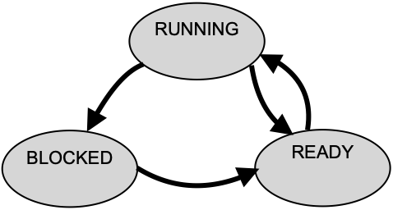
Process States
Process has different states
READY
Ready to run and pending for running
RUNNING
Being executed by OS
BLOCKED
Suspended due to some other events, e.g., I/O requests
Process 0
I/O
Process 1
Running
Ready
Request
CPU switch
I/O processing
Running
Block
I/O Done
Scheduled
Ready
I/O request
Running
Descheduled
Done
Done
I/O request
completion
What is a Process in an Operating System?
https://www.youtube.com/watch?v=vLwMl9qK4T8
Notes:
This final state can be useful as it allows other processes
(usually the parent that created the process) to examine the return code
of the process and see if the just-finished process executed successfully
(usually, programs return zero in UNIX-based systems when they have
accomplished a task successfully, and non-zero otherwise).
ZOMBIE
Completed execution but still has an entry in the system.

Slide 8
Process API
Process API to manipulate processes
CREATE
Create a new process, e.g., double click, a command in terminal
WAIT
Wait for a process to stop
Like I/O request
DESTROY
Kill the processes
STATUS
Obtain the information of a process
OTHERS
Suspend or resume a process

Slide 9
Process Creation
A process is created by another process, parent process or calling process
Process creation relies on two system calls
fork()
Create a new process and clone its parent process
exec()
Overwrite the created process with a new program

Slide 10
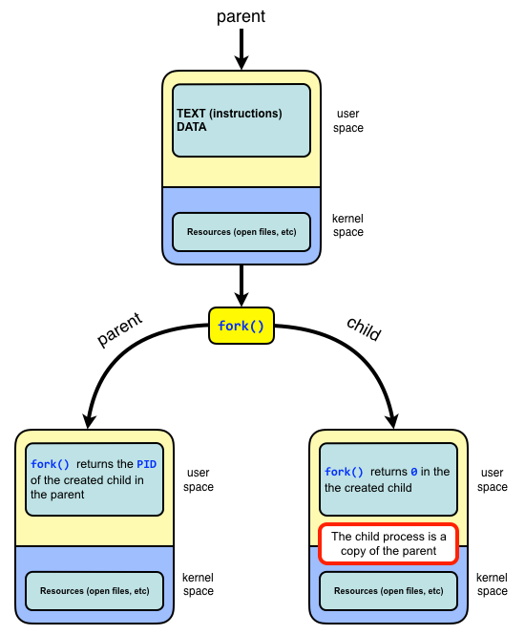
fork()
A function without any arguments
pid = fork()
Both parent process and child process continue to execute the instruction following the fork()
The return value indicates which process it is (parent or child)
Non-0 pid (pid of child process) : return value of the parent process,
0 : return value of the newly-created child process
-1 : an error or failure occurs when creating new process
Child process is a duplicate of its parent process and has same
instructions, data, stack
Child and parents have different
PIDs, memory spaces
Notes:
fork() returns 0 in child process and process ID of child process in parent process.

Slide 11
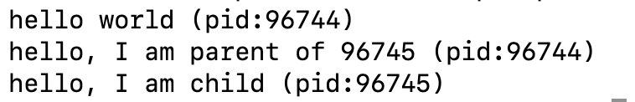
fork()
Output
int main(int argc, char *argv[])
{
printf("hello world (pid:%d)\n", (int) getpid());
int pid = fork();
if (pid < 0) {
// fork failed; exit
fprintf(stderr, "fork failed\n"); exit(1);
} else if (pid == 0) {
// child (new process)
printf("hello, I am child (pid:%d)\n", (int) getpid());
} else {
// parent goes down this path (original process)
printf("hello, I am parent of %d (pid:%d)\n", pid, (int) getpid());
}
return 0;
}
Child Process
Parent Process
Notes:
Point the next instruction after fork()

Slide 12
wait()
Let the parent process wait for the completion of the child process
pid = wait()
wait() suspends the execution of the calling process until one of its child processes terminates.
When a child process terminates, wait() retrieves its termination status and allows the system to clean up the resources associated with that child. If the parent does not call wait() to collect the child's exit status, the child becomes a zombie process, which means its PCB persists in the process table, even though it is no longer running.
While zombie processes do not consume processor or memory resources, they occupy entries in the process table. The process table is of finite size, and if too many zombie processes accumulate, it can prevent new processes from being created.
If there are multiple child processes, wait() does not allow the parent to specify which child process to wait for. waitpid(pid) is an advanced version of wait. It allows the parent process to specify which child process (or group of processes) it wants to wait for.
Parent
fork()
wait()
Child
Parent
Notes:
It will reap any terminated child arbitrarily. process (preventing it from becoming a zombie process

Slide 13
wait()
int main(int argc, char *argv[])
{
printf("hello world (pid:%d)\n", (int) getpid());
int pid = fork();
if (pid < 0) {
// fork failed; exit
fprintf(stderr, "fork failed\n");
exit(1);
} else if (pid == 0) {
// child (new process)
printf("hello, I am child (pid:%d)\n", (int) getpid());
sleep(1);
} else {
// parent goes down this path (original process). wc (wait child) stores pid of the child process waited by parent
int wc = wait(NULL); //wc contains pid of the child process being waited for by parent process
printf("hello, I am parent of %d (wc:%d) (pid:%d)\n", pid, wc, (int) getpid());
}
return 0;
}
Child process sleeps for 1 second
Parent process waits for the child process to finish sleeping
Child Process
Parent Process

Slide 14
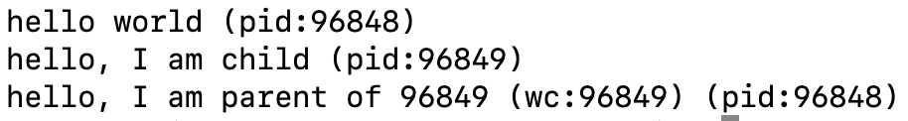
wait()
Without wait(): it is nondeterministic which process (parent or child) runs first
With wait(): child runs first, and parents waits for child to finish
Fork() system call tutorial
https://www.youtube.com/watch?v=xVSPv-9x3gk

Slide 15
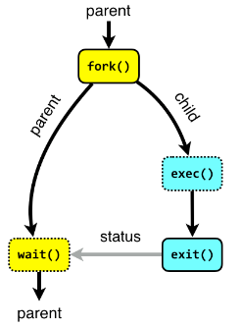
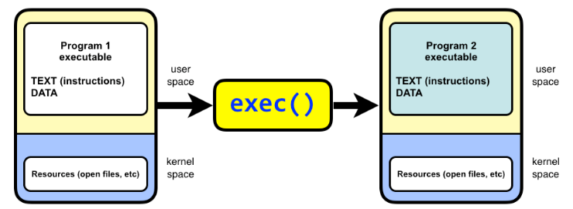
exec()
exec(cmd, argv) replaces the current process image with a new process image specified by the path to an executable file.
It does not return. It starts to execute the new program.
There is a family of exec(), e.g., execl(), execvp()
execl() takes a variable number of arguments that represent the program name and its arguments.
int execl(const char *path, const char *arg, ..., NULL);
execvp() takes an array of arguments instead of a variable-length argument list
int execvp(const char *file, char *const argv[]);
Notes:
You may not have the exec command instead you have several alternatives you can use in different situations
Returns if errors occur
Replace current data and code with new in specified file, i.e., it loads a new program into the current process
exec(cmd, argv)

Slide 16
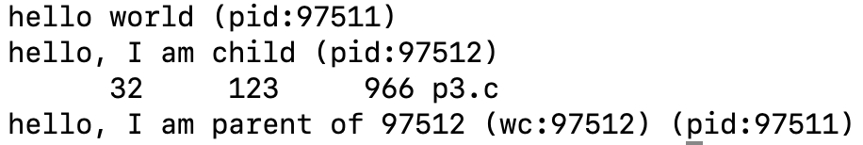
exec() Example
int main(int argc, char *argv[])
{
printf("hello world (pid:%d)\n", (int) getpid());
int pid = fork();
if (pid < 0) {
// fork failed; exit
fprintf(stderr, "fork failed\n"); exit(1);
} else if (pid == 0) { // child (new process)
printf("hello, I am child (pid:%d)\n", (int) getpid());
char *myargs[3];
myargs[0] = strdup(“wc”); // program: ”wc“ (word count)
myargs[1] = strdup(“p3.c”); // argument: file to count
myargs[2] = NULL; // marks end of array
execvp(myargs[0], myargs); // run word count
printf(“This line will never be executed.");
} else { // parent
int rc_wait = wait(NULL);
printf(“hello, I am parent of %d (rc_wait:%d) (pid:%d)\n”, rc, rc_wait, (int) getpid());}
return 0;
}
In the child process (rc == 0), the execvp() function replaces the current process image with the program named “wc“, a program that counts Lines, Words, and Bytes in a file, with output format: [lines] [words] [bytes] [filename].
The arguments for the program are passed as an array (args[]), where the first element is the program name “wc” and subsequent elements are its arguments. The array must end with NULL.
The strdup() function allocates memory on the heap and stores a copy of the string there. This is done to ensure that the strings are stored in memory that can be safely modified or freed later if needed. In this program, strdup() is not strictly necessary, and you can pass strings directly to myargs without using `strdup`, since the strings are read only and not modified later.
After call to execvp(), the whole child process address space is overwritten and replaced by the wc program, so the line “printf(“This line will never be executed.");“ is overwritten and will never be called.
Output:
Notes:
Output
b. Describe the function of execl in your own words (Hint: read the man page).
The exec family of functions replaces the current process image with a new process image. execl is a function that allows the caller to pass command line parameters to the executed program, which appear as argv array in main.
Also describe the content of the second parameter passed to execl
The second parameter is given as const char *arg0. Like printf, execl is a function with a variable number of arguments. The first one ("path") is always the Unix path of the process to execute, the subsequent ones are a list of arguments passed as argv[0], argv[1], …
The second parameter, accessible as argv[0]in the called program, by convention always contains the name of the executed program (e.g., "vim").
The command line parameters given, e.g., in the shell appear as
argv[1]…

Slide 17
IO redirection and pipe
By separating fork() and exec(), we can manipulate various settings just before executing a new program and make the IO redirection and pipe possible. (details omitted.)
IO redirection: output of the left command redirected to be written to the file on the right
Pipe: output of the left command passed as input to the right command
% cat w3.c > newfile.txt
% echo hello world | wc
Notes:
Windows has similar one, but different implementation philosophy, createprocess
standard output
Really easy to implement
On early PDP-7 computer, it only needs 27 lines of assembly code
1965

Slide 18
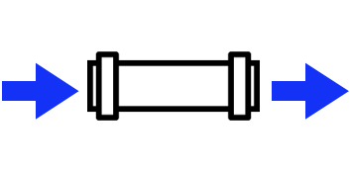

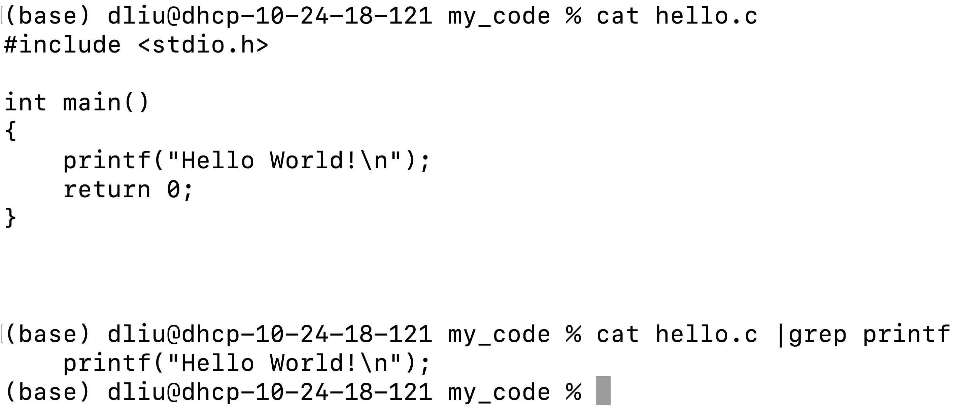
pipe
A communication method between two processes
Write
Read
Child Process (left)
Child Process (right)
Command “cat” prints out content of hello.c file
Output of “cat” command passed through the pipe
to command “grep” to search for any lines that
contain “printf”

Slide 19
Process Tree

Slide 20
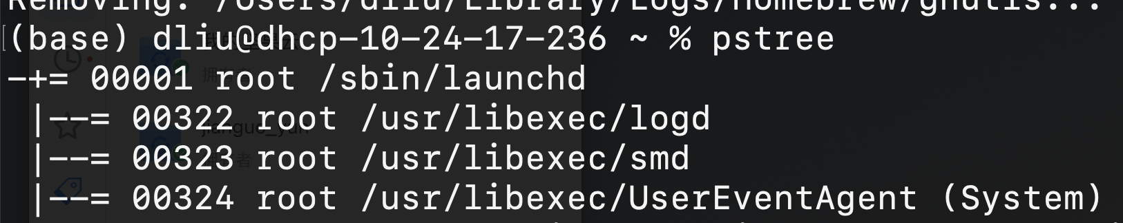
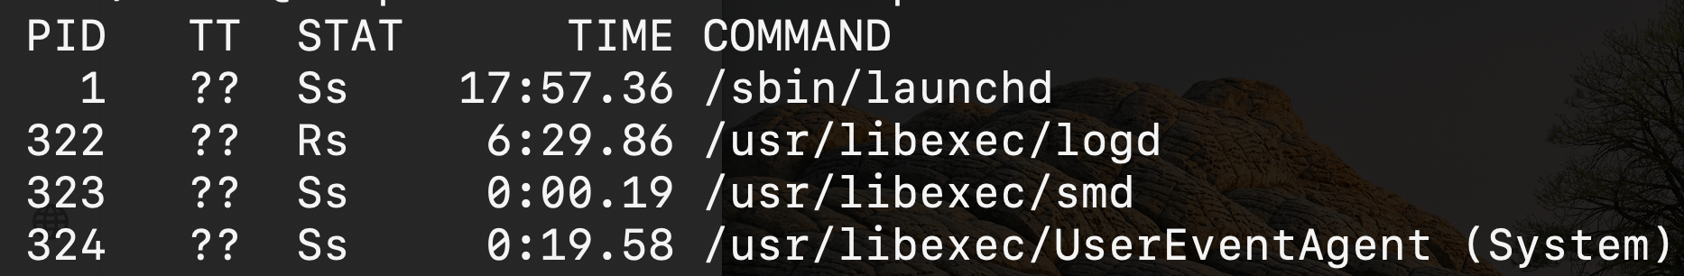
Process Tree
% pstree (to show the process tree in a hierarchy)
% ps (to show all processes as a flat list)
Notes:
percent sign

Slide 21
Quiz: Fork
#include <stdio.h>
#include <sys/types.h>
#include <unistd.h>
int main()
{
pid_t pid = fork();
if(pid<0){
perror("fork fail");
exit(1);
}
printf("Hello world!, process_id(pid) = %d\n", getpid());
return 0;
}
Since we do not check for return value of fork(), both child process and parent process run the same code after fork, and print out its own pid. (The pids 32, 33 shown are just examples.)
Since parent process and child process run concurrently without wait(), two output interleavings are possible.
In the following examples, we omit the check for p<0 and assume fork() calls are always successful.
Output: parent before child
Hello world!, process_id(pid) = 32
Hello world!, process_id(pid) = 33
or child before parent
Hello world!, process_id(pid) = 33
Hello world!, process_id(pid) = 32
https://www.geeksforgeeks.org/fork-system-call/

Slide 22
Quiz: Fork
a = 5;
if (pid=fork()==0) {
a = a + 5;
printf(“In child, a=%d, a memory address=%d\n", a, &a);
}
else {
a = a – 5;
printf(“In parent, a=%d, a memory address=%d\n", a, &a);
}
In Child (x), a = a + 5 = 10; In Parent (u), a = a – 5 = 0.
The physical addresses of ‘a’ in parent and child must be different. But our program accesses virtual addresses (assuming we are running on an OS that uses virtual memory). The child process gets an exact copy of parent process and virtual address of ‘a’ doesn’t change in child process. Therefore, we get same addresses in both parent and child. (0x1234 is just an example address.)
Output:
In parent, a = 0, a memory address=0x1234
In child, a=10, a memory address=0x1234
Or,
In child, a=10, a memory address=0x1234
In parent, a = 0, a memory address=0x1234
Notes:
Let u, v be the values printed by the parent process, and x, y be the values printed by the child process. What is the output?
ANS:
(A) u = x + 10 and v = y
(B) u = x + 10 and v != y
(C) u + 10 = x and v = y
(D) u + 10 = x and v != y
Let u, v be the values printed by the parent process, and x, y be the values printed by the child process. Which one of the following is TRUE?
(A) u = x + 10 and v = y
(B) u = x + 10 and v != y
(C) u + 10 = x and v = y
(D) u + 10 = x and v != y
The number of times ‘hello’ is printed is equal to the number of processes created. Total Number of Processes = 2^{n}, where n is the number of fork system calls. So here n = 3, 2³ = 8 Let us put some label names for the three lines:’
Let us put some label names for the three lines:
fork (); // Line 1
fork (); // Line 2
fork (); // Line 3
L1 // 1 child process created by line 1.
/ \
L2 L2 // 2 child processes created by line 2.
/ \ / \
L3 L3 L3 L3 // 4 child processes created by line 3.

Slide 23
Quiz: Fork
In general, “for (i = 0; i < n; i++) fork();” creates 1+2+…+2^(n-1)=(2^n)-1 child processes. Plus the main process P0, we have a total of 2^n processes, hence “Hello” is printed 2^n times. Here n = 3, 2^3 = 8.
Main process: P0
P0 creates 1 child process by the 1st fork: P1
P0, P1 create 2 child processes by the 2nd fork: P2, P3
P0, P1, P2, P3 create 4 child processes by the 3rd fork: P4, P5, P6, P7
Each of the 8 processes P0 to P7 prints a ”Hello”.
Order of process execution may vary depending on how OS schedules these processes, so it is non-deterministic which process gets which process ID, and which Hello is printed by which process.
None of the processes include a wait() call to handle terminated child processes. When any of these child processes terminate, their PCBs remain in the process table as no parent process is waiting on them, resulting in zombie processes.
int main() {
int i;
for (i = 0; i < 3; i++)
{fork();}
printf("Hello\n"); //outside for loop
return 0;
}
Output:
Hello
Hello
Hello
Hello
Hello
Hello
Hello
Hello
P0
start
59101
parent continues
59101
child
process created
i=0
59102
P0
P1
i=1 59101
59103
59102
59105
P0
P2
P1
P3
i=2
59101 59104
59103 59107 59102 59106 59105 59108
P0
P4
P2
P5
P1
P6
P3
P7
“Hello”
“Hello”
“Hello”
“Hello”
“Hello”
“Hello”
“Hello”
“Hello”
Notes:
#include <stdio.h>
#include <sys/types.h>
#include <unistd.h>
int main()
{
fork(); // Line 1
fork(); // Line 2
fork(); // Line 3
printf("hello\n");
return 0;
}

Slide 24
Quiz: Fork
This program will print 14 lines.
Main process: P0
P0 creates 1 child process by the 1st fork: P1. Then P0 and P1 each prints “Hello 1”
P0, P1 create 2 child processes by the 2nd fork: P2, P3. Then P0, P1, P2, P3 each prints “Hello 2”
P0, P1, P2, P3 create 4 child processes by the 3rd fork: P4, P5, P6, P7. Then P0 to P7 each prints “Hello 3”
Order of process execution may vary depending on how OS schedules these processes, so it is non-deterministic which process gets which process ID. The order in which “Hello i” is printed will respect the dependencies in the process creation tree, but parallel branches in the tree may execute in any order
e.g., “Hello 1” printed by P1 or P3 must appear after “Hello 0” printed by P1, but it may appear before or after “Hello 0” printed by P0.
int main() {
int i;
for (i = 0; i < 3; i++)
{fork();
printf("Hello i\n"); } //inside for loop
return 0;
}
P0
start
59101
parent continues
59101
child
process created
i=0
“Hello 0”
59102
“Hello 0”
P0
P1
i=1 59101
“Hello 1”
59103
“Hello 1”
59102
“Hello 1”
59105
“Hello 1”
P0
P2
P1
P3
i=2
59101 59104
59103 59107 59102 59106 59105 59108
P0
P4
P2
P5
P1
P6
P3
P7
“Hello 2”
“Hello 2”
“Hello 2”
“Hello 2”
“Hello 2”
“Hello 2”
“Hello 2”
“Hello 2”

Slide 25
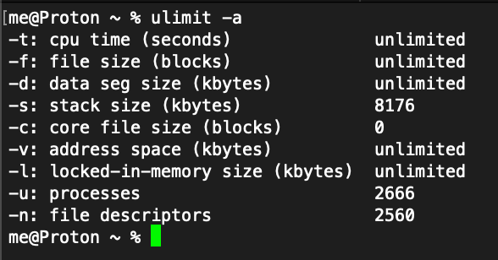
Quiz: Fork
int main() {
While(true) fork();
return 0;
}
A fork bomb is a type of denial-of-service (DoS) attack designed to exhaust system resources by creating an exponential number of processes. This is achieved through self-replicating code that repeatedly calls the fork() system call. The result is resource starvation, which can slow down or crash the system.
Prevention countermeasures:
Limit User Processes: Use ulimit in Linux to restrict the number of processes a user can create:
ulimit -u 30 # Limits user to 30 processes
Configure /etc/security/limits.conf for persistent limits:
username hard nproc 30

Slide 26
1 #include <unistd.h>
2 int main (void) {
3 pid_t pid1 = fork();
4 pid_t pid2 = fork() ;
5 if (pid1>0 && pid2==0){
6 if (pid3=fork()>0){
7 pid4=fork();}
} // end if
9 return 0;
10} // end main
Q: How many processes are generated in total?
A: There are 6 processes in total.
The initial process P0 calls pid1=fork() to generate one child process P1. P0 and P1 each calls pid2=fork() to generate child processes P2 and P3.
The if condition (pid1 > 0 && pid2 == 0) is checked in all four processes P0 to P3, and it is true only in P2 created by the pid2=fork() in P0, so P2 calls pid3=fork() to generate child process P4.
The if condition (pid3> 0) is checked in both P2 and P4. It is true in P2, so P2 calls pid4=fork() to generate child process P5. It is false in P4, so P4 stops here and does not call any more fork().
P0
start
59101
parent continues
59101
Call pid1=fork()
L3
child
process created
Call pid2=fork()
59102
P0
Call pid2=fork()
P1
L4
59101
59103
59102
59104
P0
pid1>0,
pid2==0,
call pid3=fork()
P3
P2
pid1==0, pid2>0,stop
L6
pid1>0, pid2>0, stop
P1
pid1==0, pid2==0,stop
59103 59105
pid3>0,
call pid4=fork()
P2
pid3==0.
stop
L7
P4
59103 59106
P2
P5
Notes:
Line 3: pid_t pid1 = fork(); This creates a child process. Now there are two processes: the parent and the child. executing fork on line 4. After fork returns both in P0 and P1, we have two
In the parent process, pid1 > 0, and in the child process, pid1 == 0.
Line 4: pid_t pid2 = fork(); Both the parent and child from the first fork execute this line, creating two more processes.
At this point, there are four processes: Parent process (from first fork).
Child process (from first fork).
Two new processes created by the second fork.
Lines 5-7: Conditional block. The condition if (pid1 > 0 && pid2 == 0) is checked in all four processes.
This condition is true only for the child process created by the second fork() in the original parent process.
Line 5 checks for the value returned from the first and second fork. If the first fork returned pid1 > 0 (i.e. we are in the original process P0) and the second form returned pid2==0 (i.e. we are in the child process ),
the code in lines 6-7 is executed. So we have six processes altogether.
Only in one of the processes does the condition (pid1 > 0 && pid2 == 0) hold true. That process executes another fork at line 6 and, if it is the parent, executes an additional fork at line 7. These two extra forks increase the process count by 2.

Slide 27
Quiz: Fork
Q: How many processes are generated in total? In C, the logical OR operator (||) employs short-circuit evaluation, meaning it evaluates expressions from left to right and stops as soon as the result of the entire expression is determined. Specifically for (cond1||cond2): If cond1 evaluates to true (non-zero), the overall result of the || operation is already known to be true, so cond2 is not evaluated. If cond1 evaluates to false (zero), the evaluation proceeds to the next operand cond2.
A: There are 5 processes in total.
The initial process P0 calls pid1=fork() to create child process P1. In P0, the if condition (pid1>0||?) = (true&&?)=true, so P0 skips the call pid2=fork() and calls pid3=fork() to create child process P2.
P1 has pid1==0, so it calls pid2=fork() and creates child process P3. The if condition (pid1>0|| pid2>0) is checked in both P1 and P3. In P1, it is (false||true)=true, so P1 calls pid3=fork() to create child process P4. In P3, it is (false||false)=false, so it stops here and does not call any more fork().
1 #include <unistd.h>
2 int main (void) {
3 if(pid1=fork()>0||pid2=fork()>0)
{pid3=fork();}
return 0:
5 }
P0
59101
parent continues
59101
Call pid1=fork()
child
process created
pid1>0, call pid3=fork()
59102
pid1==0,
call pid2=fork()
P0
P1
59101
59103
59102
59104
pid1==0, pid2>0, call
pid3=fork()
P3
P0
P2
P1
pid1==0, pid2==0,stop
59102 59105
P1
P4
Notes:
Line 3: Parent P0 calls pid1=fork() to create child process P1. In P0, the if condition (pid1>0||?) = (true&&?)=true, so it stops here and does not call any more fork(). (? stands for either true or false).
Line 4: In P0, since pid1 > 0 in P0, the condition (pid1=fork()||pid2=fork())=(true||?)=true, so P0 goes into Line 4 and calls pid3=fork() to create child process P2.
Line 3: Child P1 has pid1==0, so it calls pid2=fork() and creates child process P3. In P3, (pid1=fork()||pid2=fork())=(false||false)=false, so it does not go into Line 4.
Line 4: In P1, since pid2>0, the condition (pid1=fork()||pid2=fork())=(false||true)=true, so P1 goes into Line 4 and calls pid3=fork() to create child process P4.
Each of the 5 processes P0 to P4 prints a ”Hello”.

Slide 28
TODO Quiz: Fork
Q: How many processes are generated in total? In C, the logical OR operator (||) employs short-circuit evaluation, meaning it evaluates expressions from left to right and stops as soon as the result of the entire expression is determined. Specifically for (cond1||cond2): If cond1 evaluates to true (non-zero), the overall result of the || operation is already known to be true, so cond2 is not evaluated. If cond1 evaluates to false (zero), the evaluation proceeds to the next operand cond2.
A: There are 5 processes in total.
The initial process P0 calls pid1=fork() to create child process P1. In P0, the if condition (pid1>0||?) = (true&&?)=true, so P0 skips the call pid2=fork() and calls pid3=fork() to create child process P2.
P1 has pid1==0, so it calls pid2=fork() and creates child process P3. The if condition (pid1>0|| pid2>0) is checked in both P1 and P3. In P1, it is (false||true)=true, so P1 calls pid3=fork() to create child process P4. In P3, it is (false||false)=false, so it stops here and does not call any more fork().
1 #include <unistd.h>
2 int main (void) {
3 if(pid1=fork()>0||pid2=fork()>0)
4 {pid3=fork();}
5 }
P0
59101
parent continues
59101
Call pid1=fork()
child
process created
pid1>0, call pid3=fork()
59102
pid1==0,
call pid2=fork()
P0
P1
59101
59103
59102
59104
pid1==0, pid2>0, call
pid3=fork()
P3
P0
P2
P1
pid1==0, pid2==0,stop
59102 59105
P1
P4
Notes:
Line 3: Parent P0 calls pid1=fork() to create child process P1. In P0, the if condition (pid1>0||?) = (true&&?)=true, so it stops here and does not call any more fork(). (? stands for either true or false).
Line 4: In P0, since pid1 > 0 in P0, the condition (pid1=fork()||pid2=fork())=(true||?)=true, so P0 goes into Line 4 and calls pid3=fork() to create child process P2.
Line 3: Child P1 has pid1==0, so it calls pid2=fork() and creates child process P3. In P3, (pid1=fork()||pid2=fork())=(false||false)=false, so it does not go into Line 4.
Line 4: In P1, since pid2>0, the condition (pid1=fork()||pid2=fork())=(false||true)=true, so P1 goes into Line 4 and calls pid3=fork() to create child process P4.
Each of the 5 processes P0 to P4 prints a ”Hello”.

Slide 29
User/Kernel Mode Separation
User mode: restricted, limited operations
Processes start in user mode
Kernel mode: privileged, not restricted
OS starts in kernel mode
What if a process wants to perform some restricted operations?
System calls: Allow the kernel services to provide some functionalities to user programs

Slide 30
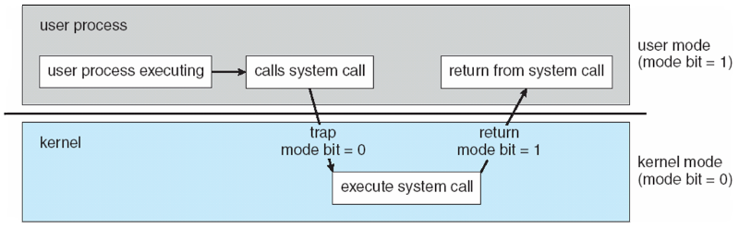
User/Kernel Mode Separation
A process starts in user mode
If it needs to perform a restricted operation, it calls a system call by executing a trap instruction.
The state and registers of the calling process are stored, the system enters kernel mode, OS completes the syscall work.
Return from syscall, restore the states and registers of the process, and resume the execution of the process

Slide 31
Process Scheduling
Switching Between Processes
Cooperative approach
Trust process to relinquish processor time to OS through yield()
Non-cooperative approach
The OS takes control periodically, e.g., timer interrupter
Notes:
When a process is running on cpu, this means the process is not running

Slide 32
Process Summary
In OS, process is a running program and has an address space
We use process API to create and manage processes
Fork() to duplicate a process, exec() to replace the command
Process scheduling

Slide 33
What’s in a process?
A process consists of:
an address space
the code for the running program
the data for the running program
at least one thread
Registers, IP
Floating point state
Stack and stack pointer
a set of OS resources
open files, network connections, sound channels, …
Today: decompose process from threads of control
Notes:
(other resources…)

Slide 34
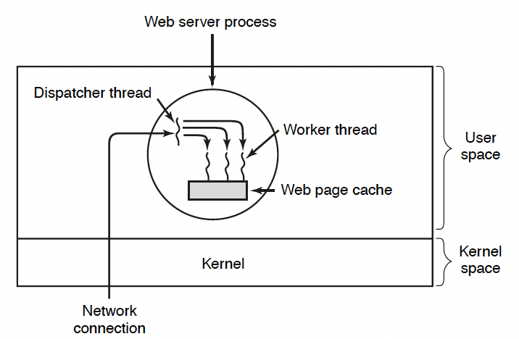
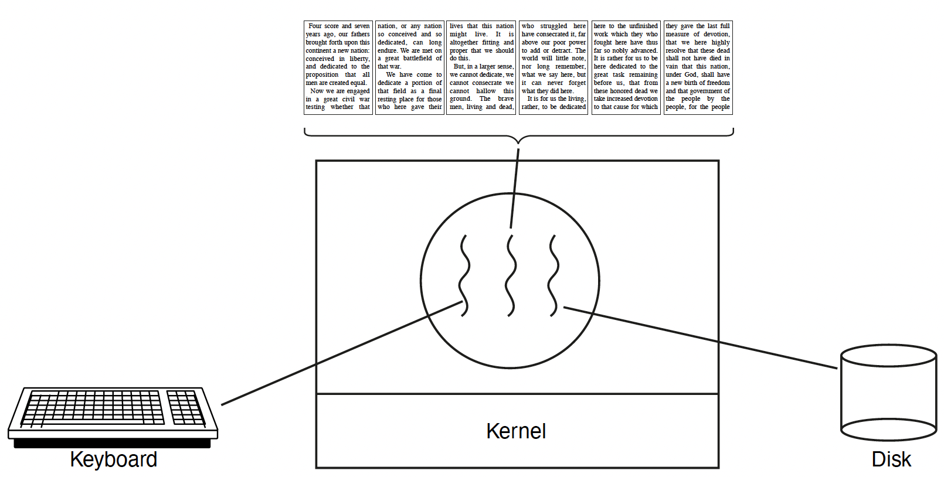
Concurrency
Imagine a web server that handles multiple requests concurrently
Multiple worker threads: while waiting for the credit card server to approve a purchase for one client, it could be retrieving the data requested by another client from disk, and assembling the response for a third client from cached information
Imagine a web client (browser), which might like to initiate multiple requests concurrently
Imagine a parallel program running on a multiprocessor, which might like to employ parallelism = “true concurrency”
For example, multiplying a large matrix – split the output matrix into k regions and compute the entries in each region concurrently using k processors
Thread for Displaying
Thread for disk IO
Thread for keyboard input
Web Server
Web Browser

Slide 35
What’s needed?
In each of these examples of concurrency (web server, web client, parallel program):
Everybody wants to run the same code
Everybody wants to access the same data
Everybody has the same privileges
Everybody uses the same resources (open files, network connections, etc.)
But you’d like to have multiple hardware execution states:
an execution stack and stack pointer (SP)
traces state of procedure calls made
program counter (PC), indicating the next instruction
a set of general-purpose processor registers and their values
Creating multiple processes is inefficient
Key idea: separate the concept of a process (address space, etc.) from that of a minimal “thread of control” (execution state: PC, etc.)
This execution state is usually called a thread, or sometimes, a lightweight process
Notes:
Given the process abstraction as we know it:
create several processes
cause each to map to the same physical memory to share data
see the MapViewOfFile() system call for one way to do this (kind of)
This is like making a pig fly – it’s really inefficient
space: _KPROCESS, page tables, etc.
time: creating OS structures, initializing addr space, etc.
Some equally bad alternatives for some of the examples:
Entirely separate web servers
Manually programmed asynchronous programming (non-blocking I/O) in the web client (browser)

Slide 36
Processes and Threads
Modern OSes support two entities:
the process, which defines the address space and general process attributes (such as open files, etc.)
the thread, which defines a sequential execution stream within a process
A thread is bound to a single process / address space
address spaces, however, can have multiple threads executing within them
threads in the same process share the same address space, making it easy to share data among them
Threads become the unit of scheduling
processes / address spaces are just containers in which threads execute

Slide 37
Processes and Threads
Multiple threads within a process will share
Process ID
The address space: code, most data (heap)
Open files (file descriptors)
Current working directory
Other resources
Each thread has its own:
Thread ID (TID)
Set of registers, including Program Counter and Stack Pointer
Stack for local variables and return addresses
Advantages
Efficient and fast resource sharing
Efficient utilization of many CPU cores with only one process
Less context switching overheads

Slide 38
(old) Process address space
0xFFFFFFFF
stack
(dynamic allocated mem)
SP (Stack Pointer)
address space
heap
(dynamic allocated mem)
static data
(data segment)
code
(text segment)
PC (Program Counter)
0x00000000

Slide 39
(new) Process address space with threads
thread 1 stack
SP (T1)
0xFFFFFFFF
thread 2 stack
SP (T2)
thread 3 stack
SP (T3)
address space
heap
(dynamic allocated mem)
static data
(data segment)
0x00000000
code
(text segment)
PC (T2)
PC (T1)
PC (T3)

Slide 40
Process/thread separation
Concurrency (multithreading) is useful for:
handling concurrent events (e.g., web servers and clients)
building parallel programs (e.g., matrix multiply, ray tracing)
improving program structure
Multithreading is useful even on a uniprocessor
even though only one thread can run at a time, multiple threads may be executed in a time-sharing schedule, so they appear to run concurrently
Supporting multithreading – that is, separating the concept of a process (address space, files, etc.) from that of a minimal thread of control (execution state), is a big win
creating concurrency does not require creating new processes
faster / better / cheaper

Slide 41
POSIX pthreads API
POSIX thread -> pthread
A Portable Operating System Interface (POSIX) library (IEEE 1003.1c), written in C language
Pthread library: 60+ functions, API specifies behavior of the thread library
API | Functionality
pthread_create | Create a new thread in the caller’s address space
pthread_exit | Terminate the calling thread
pthread_join | Wait for a thread to terminate
pthread_mutex_lock | Lock a mutex
pthread_mutex_unlock | Unlock a mutex
sem_wait | Wait on a semaphore
sem_post | Signal or post on a semaphore
pthread_cond_wait | Wait on a condition variable
pthread_cond_signal | Wake up one thread waiting on a condition variable
pthread_cond_broadcast | Wake up all threads waiting on a condition variable
Notes:
pthread_mutex_init
Create a new mutex
pthread_mutex_destroy
Destroy a mutex
t = pthread_create(attributes, start_procedure)
creates a new thread of control
new thread begins executing at start_procedure
pthread_cond_wait(condition_variable)
the calling thread blocks, sometimes called thread_block()
pthread_signal(condition_variable)
starts the thread waiting on the condition variable
pthread_exit()
terminates the calling thread
pthread_wait(t)
waits for the named thread to terminate

Slide 42
Pthread Fork-Join Pattern
void *mythread(void *arg) {
printf("%s\n", (char *) arg);
return NULL;
}
int main(int argc, char *argv[]) {
pthread_t p1, p2;
printf("main: begin\n");
pthread_create(&p1, NULL, mythread, "A");
pthread_create(&p2, NULL, mythread, "B");
// join waits for the threads to finish
pthread_join(p1, NULL);
pthread_join(p2, NULL);
printf("main: end\n");
}
create
exit
join
Main thread creates multiple sub-threads, passing them args to work on… then joins with them to collect results.

Slide 43
“Where do threads come from?”
The kernel is responsible for creating/managing threads
for example, the kernel call to create a new thread would
allocate an execution stack within the process address space
create and initialize a Thread Control Block
stack pointer, program counter, register values
stick it on the ready queue
we call these kernel threads

Slide 44
“Where do threads come from?” (2)
Threads can also be managed at the user level (that is, entirely from within the process)
a library linked into the program manages the threads
because threads share the same address space, the thread manager doesn’t need to manipulate address spaces (which only the kernel can do)
threads differ (roughly) only in hardware contexts (PC, SP, registers), which can be manipulated by user-level code
the Linux thread package multiplexes user-level threads on top of kernel thread(s), which it treats as “virtual processors”
we call these user-level threads

Slide 45
Kernel threads
OS now manages threads and processes
all thread operations are implemented in the kernel
OS schedules all of the threads in a system
if one thread in a process blocks (e.g., on I/O), the OS knows about it, and can run other threads from that process
possible to overlap I/O and computation inside a process
Kernel threads are cheaper than processes
less state to allocate and initialize
But, they’re still expensive for fine-grained use (e.g., orders of magnitude more expensive than a procedure call)
thread operations are all system calls
context switch
argument checks
must maintain kernel state for each thread

Slide 46
User-level threads
To make threads cheap and fast, they may be implemented at the user level
managed entirely by user-level library, e.g., libpthreads.a
User-level threads are small and fast
each thread is represented simply by a PC, registers, a stack, and a small thread control block (user-space TCB)
creating a thread, switching between threads, and synchronizing threads are done via procedure calls
no kernel involvement is necessary!
user-level thread operations can be 10-100x faster than kernel threads as a result
The OS kernel scheduler schedules the kernel threads; the user-level thread scheduler within each process schedules the user-level threads within the time intervals that the underlying kernel thread runs.
it uses queues to keep track of the thread states: run, ready, wait. Just like the OS kernel scheduler, but implemented as a user-level library
Example implementations of user-level threads
Fibers, co-routines
FANG Interview Question | Process vs Thread
https://www.youtube.com/watch?v=4rLW7zg21gI
Notes:
The kernel believes the user-level process is just a normal process running code
But, this code includes the thread support library and its associated thread scheduler

Slide 47
Summary
Processes
In OS, process is a running program and has an address space
We use process API to create and manage processes
Fork() to duplicate a process, exec() to replace the command
Threads:
Multiple threads per process / address space
Kernel threads are much more efficient than processes, but they’re still not cheap
all operations require a kernel call and parameter verification
User-level threads are very efficient
Notes:
What is Thread Synchronization?
https://www.youtube.com/watch?v=8_CRd1R5g98
fast
great for common-case operations
creation, synchronization, destruction
can suffer in uncommon cases due to kernel obliviousness
I/O
preemption of a lock-holder

